Slide 1
COMP 2230
Week 3 - Wednesday

Slide 2
Last time
Arguments with quantifiers
Proving existential statements and disproving universal ones
Proving universal statements

Slide 3
Questions?

Slide 4
Assignment 1

Slide 5
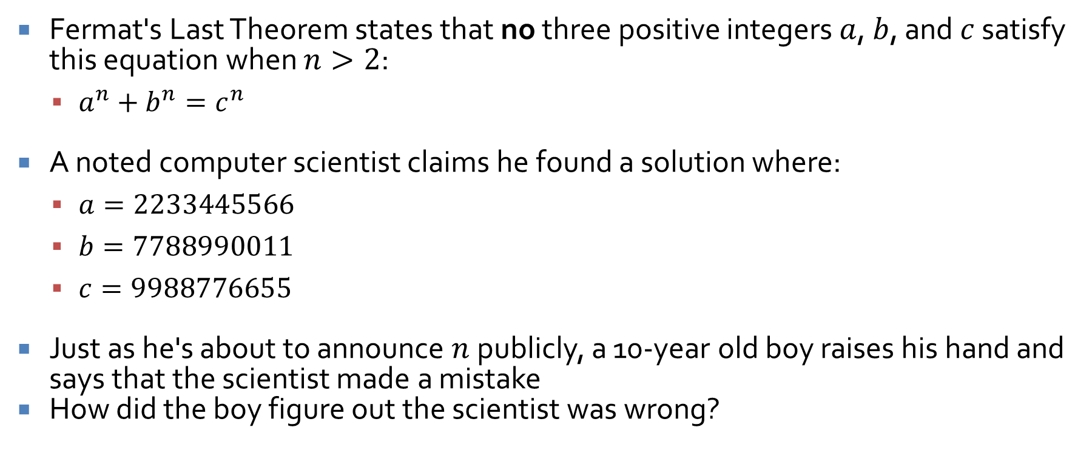
Logical warmup
Fermat's Last Theorem states that no three positive integers $a$, $b$, and $c$ satisfy this equation when $n>2$:
  $a^{n}+b^{n}=c^{n}$
A noted computer scientist claims he found a solution where:
  $a=2233445566$
  $b=7788990011$
  $c=9988776655$
Just as he's about to announce $n$ publicly, a 10-year old boy raises his hand and says that the scientist made a mistake
How did the boy figure out the scientist was wrong?

Slide 6
Rational Numbers

Slide 7

Another important definition
A real number is rational if and only if it can be expressed at the quotient of two integers with a nonzero denominator
Or, more formally,
  $r$ is rational $ ∃ a, b ∈ℤ, r = \frac{a}{b}$and$b  0$

Slide 8
Prove the following:
Every integer is a rational number
The sum of any two rational numbers is rational
The product of any two rational numbers is a rational number

Slide 9
Prove or disprove:
The reciprocal of any rational number is a rational number

Slide 10
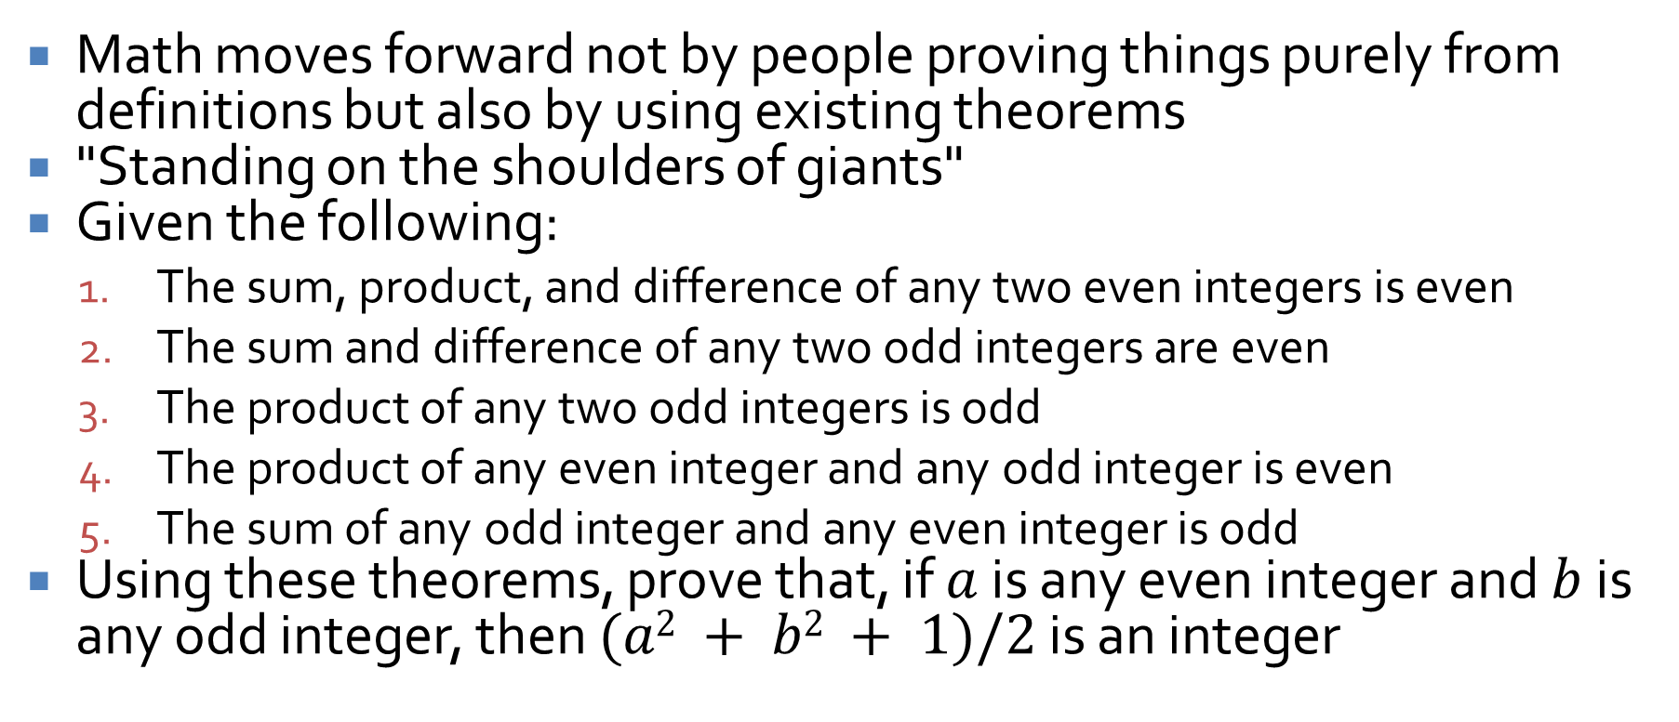
Using existing theorems
Math moves forward not by people proving things purely from definitions but also by using existing theorems
"Standing on the shoulders of giants"
Given the following:
  The sum, product, and difference of any two even integers is even
  The sum and difference of any two odd integers are even
  The product of any two odd integers is odd
  The product of any even integer and any odd integer is even
  The sum of any odd integer and any even integer is odd
Using these theorems, prove that, if $a$ is any even integer and $b$ is any odd integer, then $(a2 + b2 + 1)/2$ is an integer

Slide 11
Divisibility

Slide 12
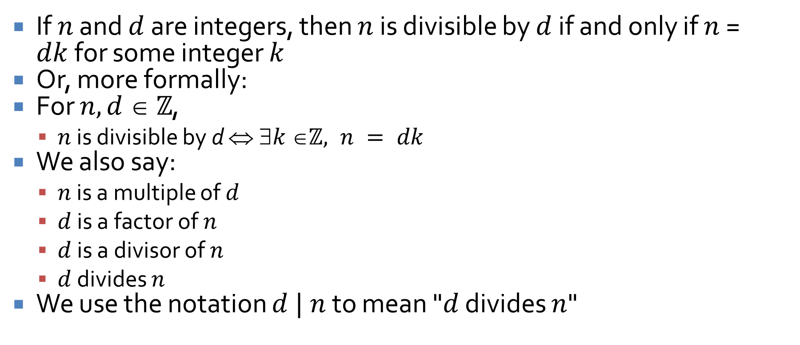
Definition of divisibility
If $n$ and $d$ are integers, then $n$ is divisible by $d$ if and only if $n$ = $dk$for some integer $k$
Or, more formally:
For $n, d  ℤ$,
  $n$ is divisible by d $ k ℤ, n = dk$
We also say:
  $n$ is a multiple of $d$
  $d$ is a factor of $n$
  $d$ is a divisor of $n$
  $d$ divides $n$
We use the notation $d | n$ to mean "$d$ divides $n$"

Slide 13
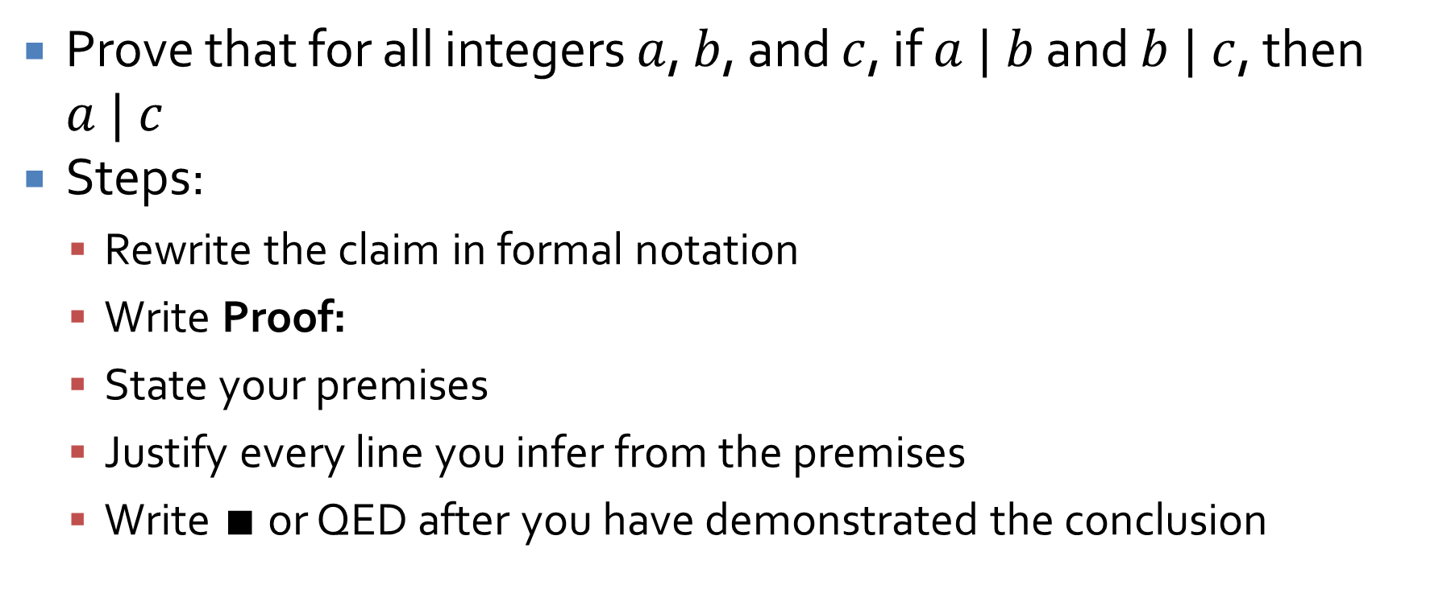
Transitivity of divisibility
Prove that for all integers $a$, $b$, and $c$, if $a | b$ and $b | c$, then $a | c$
Steps:
  Rewrite the claim in formal notation
  Write Proof:
  State your premises
  Justify every line you infer from the premises
  Write $∎$ or QED after you have demonstrated the conclusion

Slide 14

Prove or disprove:
For all integers $a$ and $b$, if $a | b$ and $b | a$, then $a = b$
How could we change this statement so that it is true?
Then, how could we prove it?

Slide 15
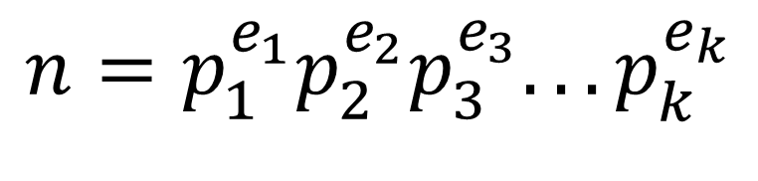
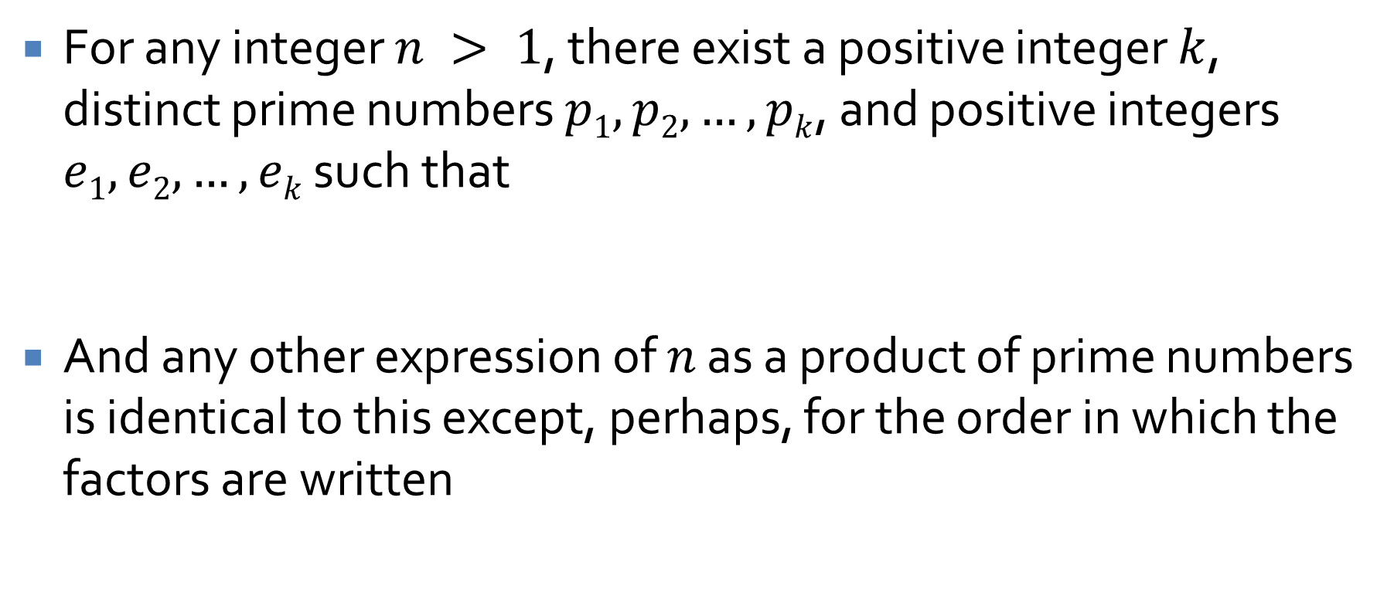
Unique factorization theorem
For any integer $n > 1$, there exist a positive integer $k$, distinct prime numbers $p1, p2, …, pk$, and positive integers $e1, e2, …, ek$ such that
And any other expression of $n$ as a product of prime numbers is identical to this except, perhaps, for the order in which the factors are written
$$n=p_{1}^{e_{1}}p_{2}^{e_{2}}p_{3}^{e_{3}}...p_{k}^{e_{k}}$$

Slide 16
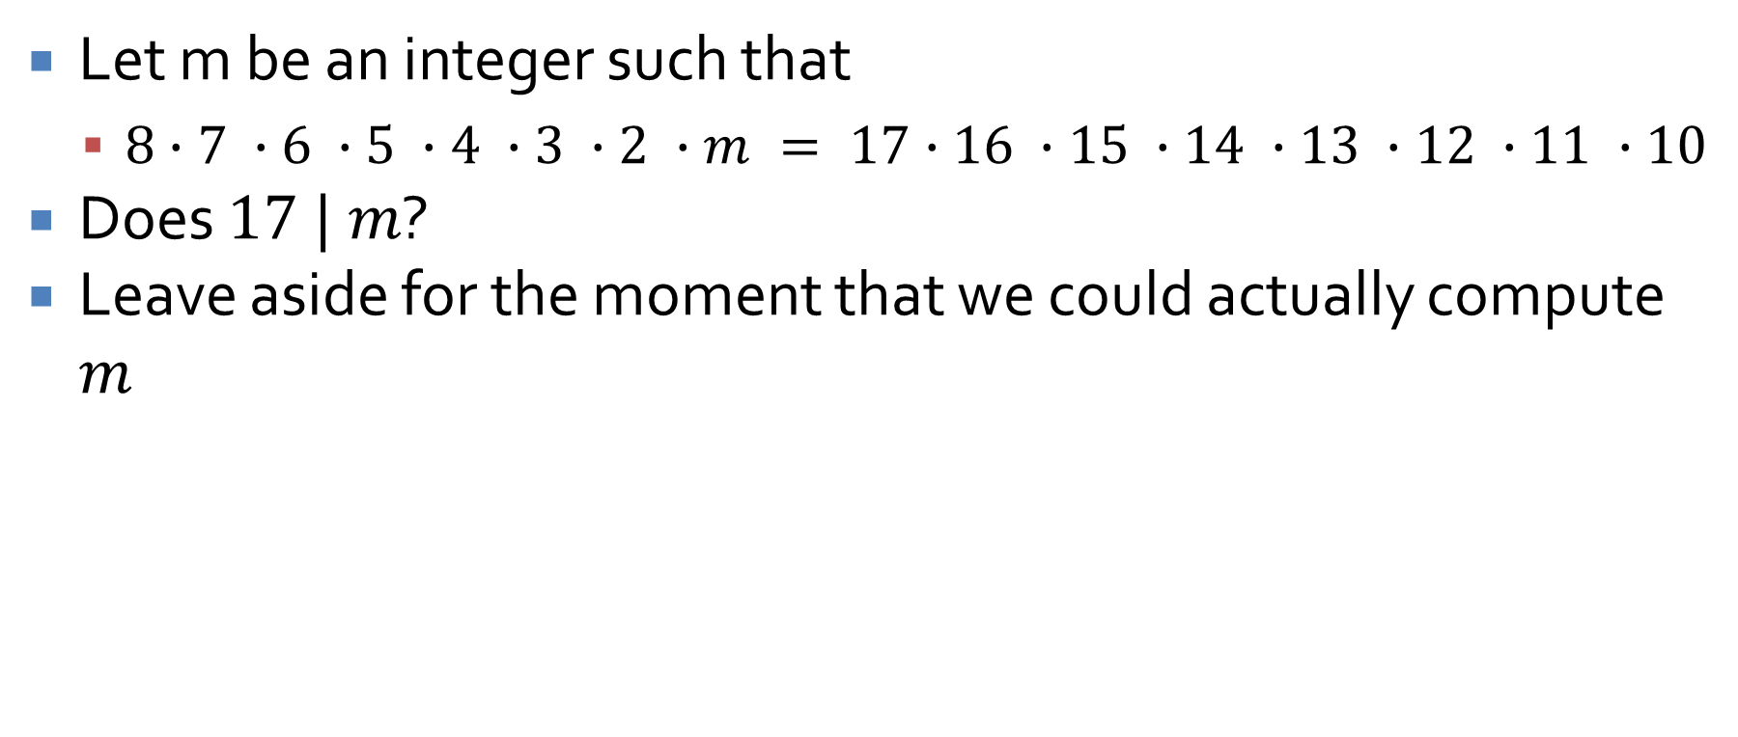
An application of the unique factorization theorem
Let m be an integer such that
  $8∙7 ∙6 ∙5 ∙4 ∙3 ∙2 ∙m = 17∙16 ∙15 ∙14 ∙13 ∙12 ∙11 ∙10$
Does $17 | m$?
Leave aside for the moment that we could actually compute $m$

Slide 17
Floor and Ceiling

Slide 18
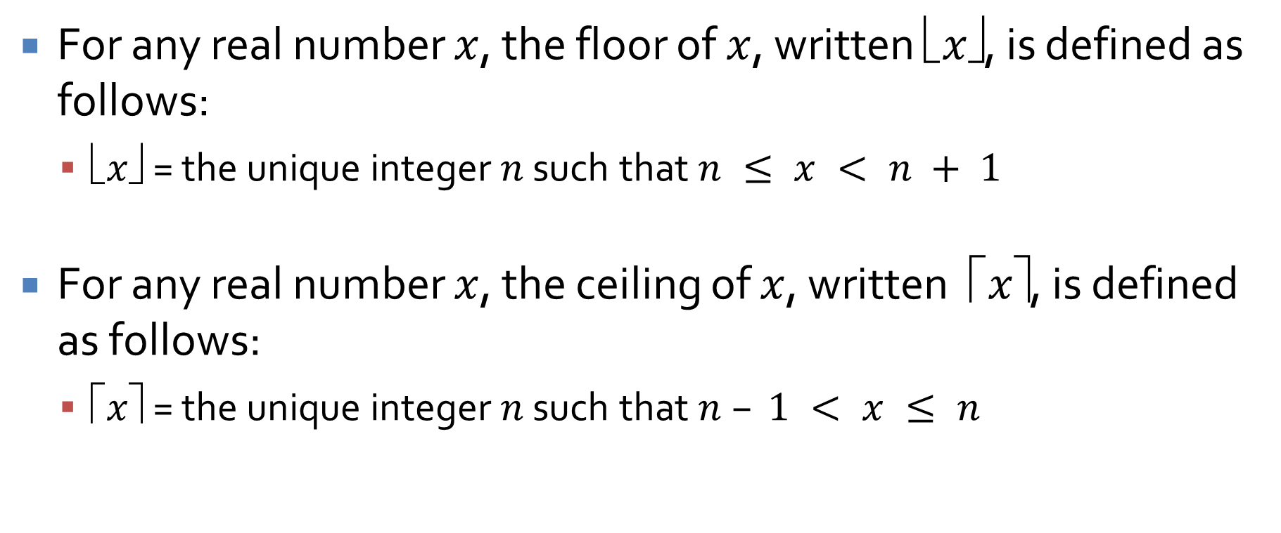
More definitions
For any real number $x$, the floor of $x$, written $x✗$, is defined as follows:
  $x✗$ = the unique integer $n$ such that $n ≤ x < n + 1$
For any real number $x$, the ceiling of $x$, written $ ⬆x$, is defined as follows:
  $⬆x$ = the unique integer $n$ such that $n – 1 < x ≤ n$

Slide 19

Proofs with floor and ceiling
Prove or disprove:
  $x, y ℝ, x + y✗ = x✗ + y✗$
Prove or disprove:
  $x ℝ, m ℤ x + m✗ = x✗ + m$

Slide 20
Ticket Out the Door

Slide 21
Upcoming

Slide 22
Next time…
Proofs by contradiction

Slide 23
Reminders
Read Sections 4.6, 4.7, and 4.8
Finish Assignment 1
  Due Friday!
Review for Exam 1
  Next Monday!

